Slide 1
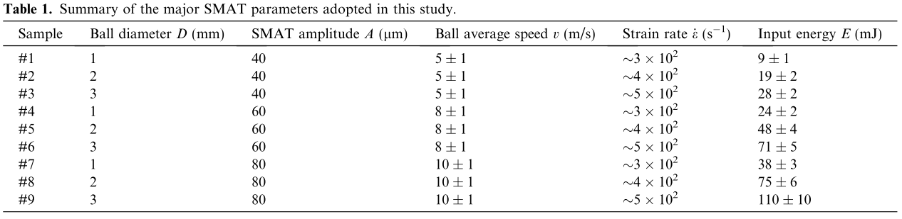
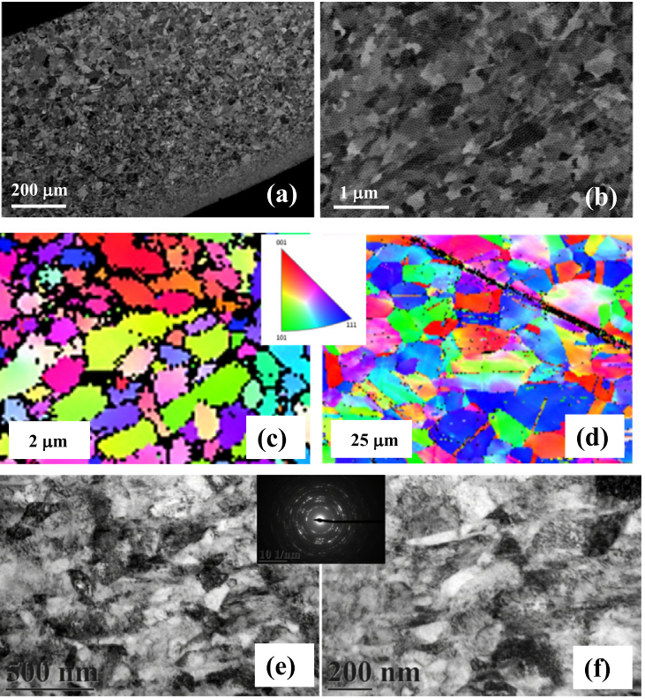
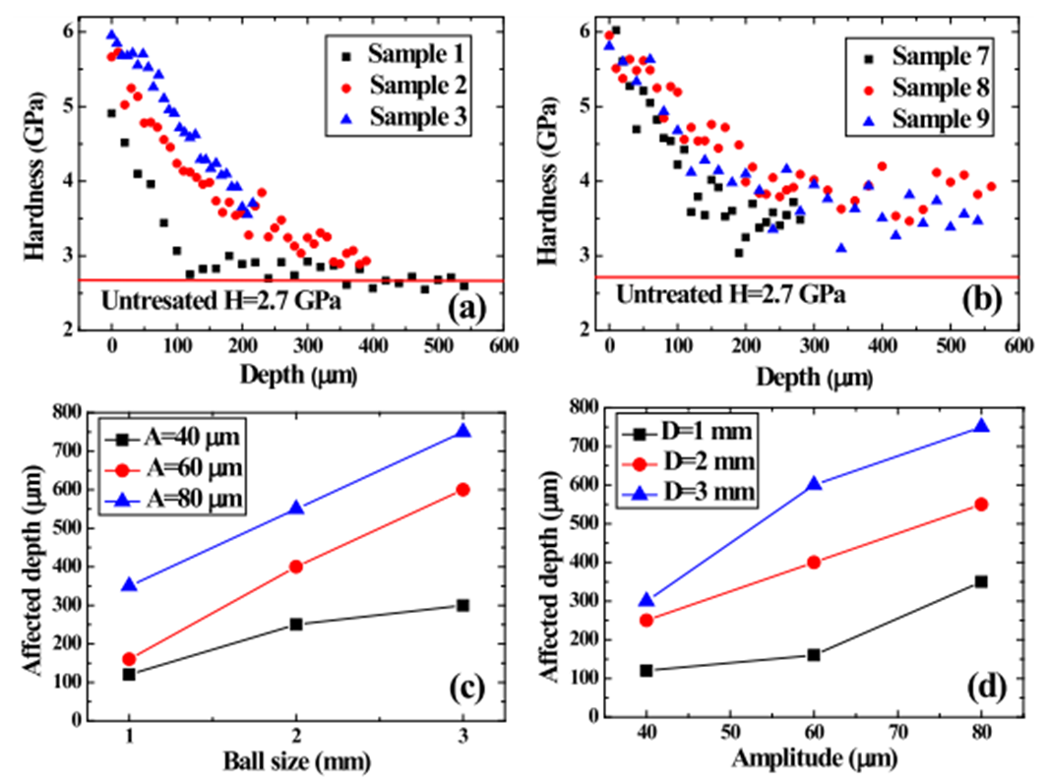
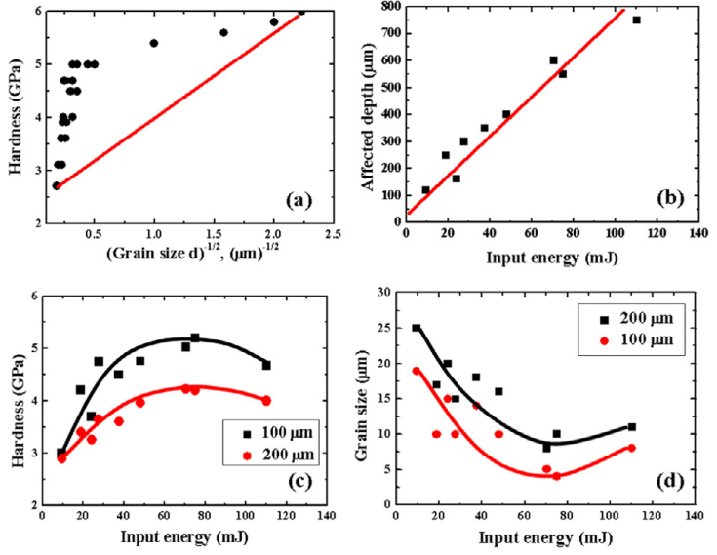
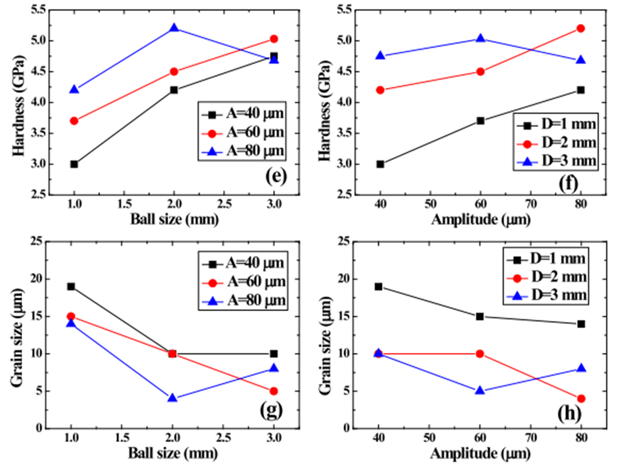
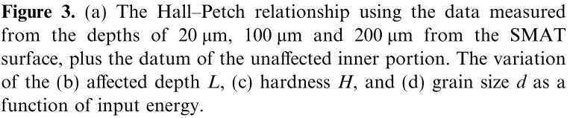
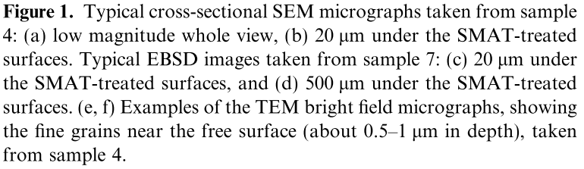
Relationship between microstructure and properties for ultrasonic surface
mechanical attrition treatment
W.Y. Tsai, J.C. Huang, Yu Jia Gao, Y.L. Chung and Guan-Rong Huang
Department of Materials and Optoelectronic ScienceNational Sun Yat-Sen University, Kaohsiung 804, Taiwan, ROC *Correspondent author: Tel.: +886-7-525-4070; Fax.: +886-7-525-4099. Electronic mail: jacobc@mail.nsysu.edu.tw.
Abstract
The analytic modeling and one experimental assess of the ultrasonic surface mechanical attrition treatment are presented. The bombarding ballspeed, induced energy, hardness and grain size are incorporated into this model, based on harmonic longitudinal vibration motion of ultrasonic-wave-driven impact. There appear some optimum attrition working parameters for the best attrition eﬀect; beyond which, the sample surface would be subject to bombarding microcracking and the grain size would not be further reduced. The beneﬁts from attrition would become lower.
Results
Volume fraction
Mg55: <1%
Mg60:2.5 %
Mg65: 3.5%
Mg55
Mg60
Mg65
Mg
Conclusions
1. The model based on the harmonic longitudinal vibration motion can accurately predict the SMAT process.
2. Beyond the optimum SMAT parameters, the sample surface would be subject to bombarding microcracking and the grain size would not be further reduced.
3. From Figure 3(c) and (d), it is demonstrated that, with the high input energy, the hardness could start to decline and the grain size could start to grow.
3. The measured hardness readings are all higher than the Hall-Petch line, suggesting there is contribution other than grain size hardening. With the severe SMAT attrition at controlled temperatures below 100ºC, work hardening by dislocations and twins contributed appreciably to the observed hardness.

